Slide 1
Predicting the impact of an oil or gas discovery on the future GDP growth of a country
Example of Guyana

Slide 2
Introduction
The impact of oil discoveries can be significant on the economy of a country. During the industrialization of the 20th century several major oil discoveries have shaped the economies of entire regions, and tremendous amount of economic growth was generated as result, changing the livelihood of millions of people around the world. The most well know oil regions are in the Middle East, Russia, Central Asia, North Africa and Latin America. The economies of oil exporting countries and their GDP have become heavily dependent on the export of its precious crude and its derivatives since the second half of the 20th centuries.

Slide 3
Problematic
In 2015 Guyana, a small country in northern part of South America, made a significant oil discovery that is estimated to about 8 billion barrels. The country's population is less than a million and the main economy was based on agriculture, fishing and mining. The oil discovery made by Exxon Mobil and its partners in the Stabroek block offshore is poised to change the economy and the GDP of the country. A CNBC article dated from Nov 9th, 2019 mentions that the IMF estimates that Guyana will see an 86% of annual economic growth in 2020 as a result of production. Although that number is quoted to be ambitious given the current political and financial contexts. On the other hand, IHS Markit predicts a more reasonable 30% GDP growth for 2020. So how can one quantify the impact of this discovery on the country's GDP over the next few years? And which of the two estimates would be more likely?

Slide 4
Dataset
Economic Indicators from the World Bank database (1960-2010)
Fuel Exports
GDP Growth
GDP Growth per Capita
Oil and Gas Discoveries
Field discovered between 1868 and 2010
Source: American Association of Petroleum Geologists (Data gathered worldmap.harvard.edu)

Slide 5
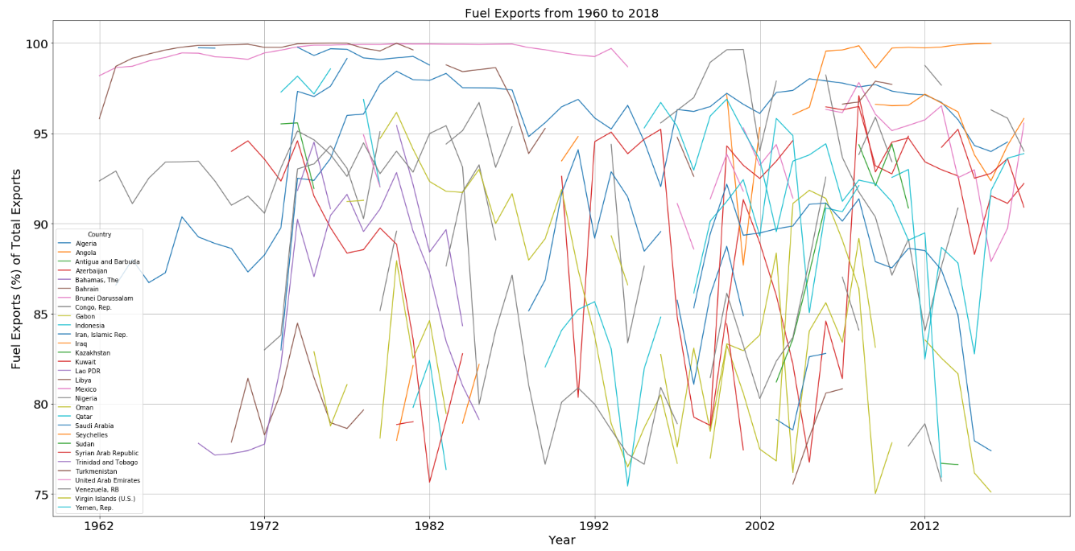
Fuel Exports
Fuel exports includes all commodities defined within the Standard International Trade Classification (SITC) category of mineral fuels, lubricants and related materials.
Countries with fuel exports >75% of total exports
GDP and GDP growth for such countries are highly dependent on oil and gas exports

Slide 6
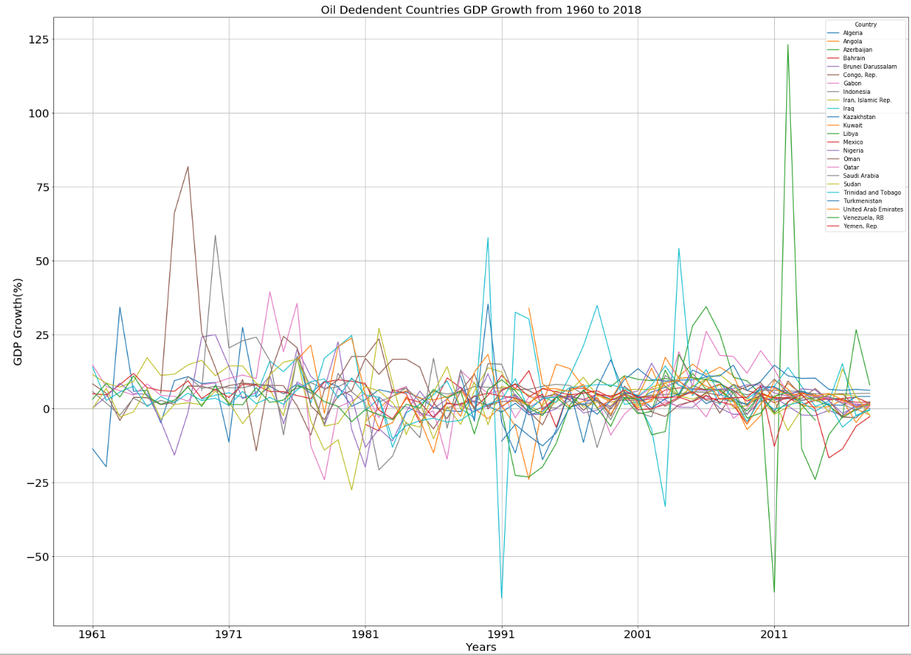
GDP Growth
The gross domestic product (GDP) growth rate measures how fast the economy is growing
GDP growth (%) overall between -25 and +35%

Slide 7
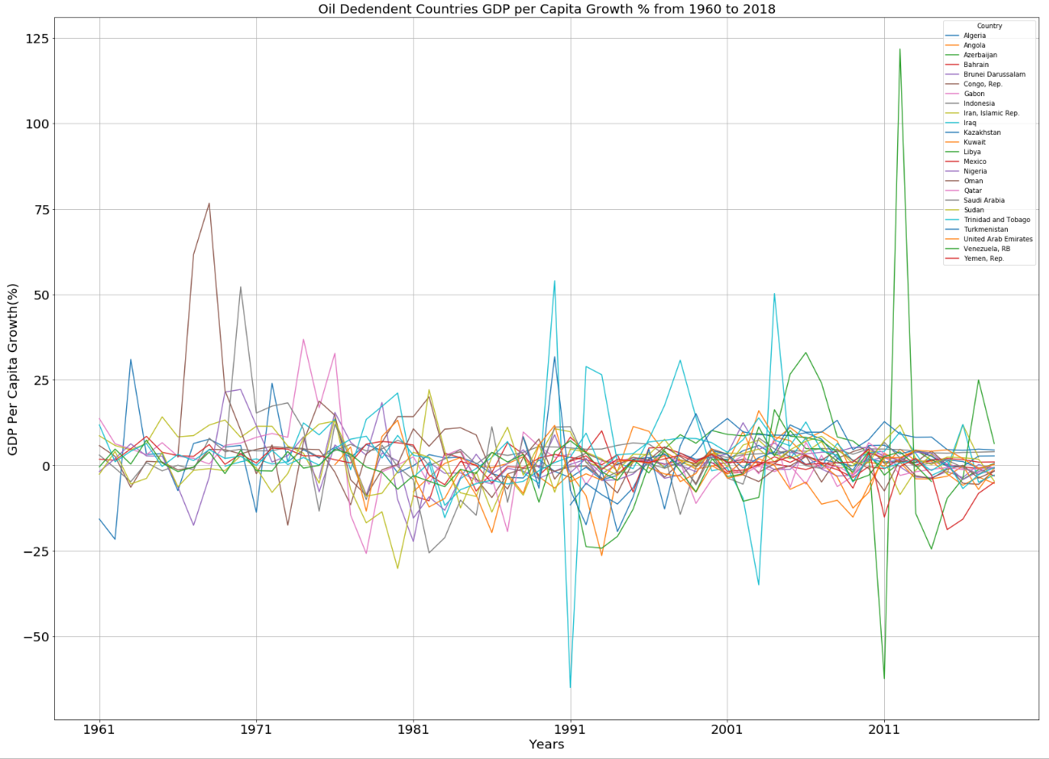
GDP Growth per Capita
GDP per capita is a measure of a country's economic output that accounts for its number of people
Annual growth rate of real Gross Domestic Product (GDP) per capita is calculated as the percentage change in the real GDP per capita between two consecutive years.
Values plotted for 24 oil exporting countries vary between -25% and +25% overall

Slide 8
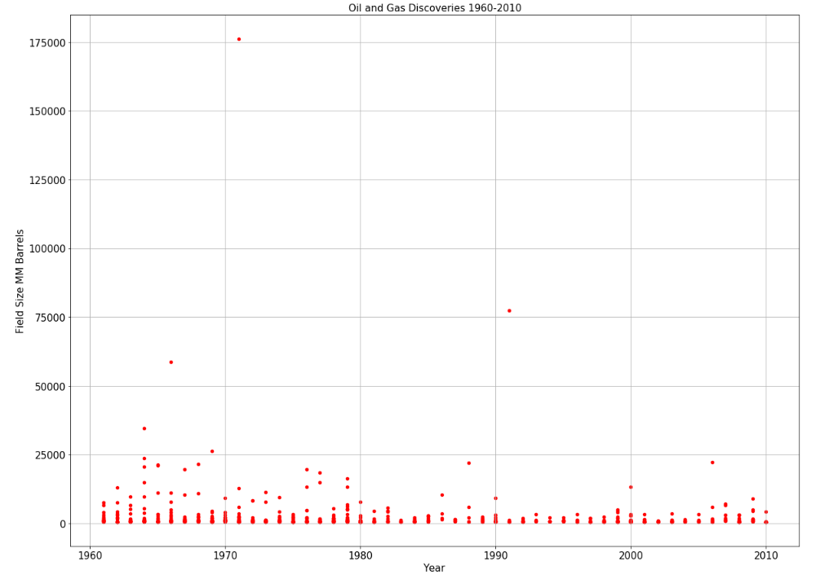
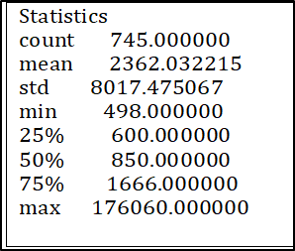
Oil and Gas Discoveries
Filtered discoveries from 1960 to 2010 to coincide with time period of world bank indicators
Plot of oil and gas discoveries
North Field (Qatar)
Pars South (Iran)
Urengoy (Russia)
Marun (Iran)
Yamburg (Russia)
Shotkman (Russia)
Yolotan(Tukmenistan)

Slide 9
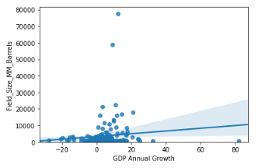
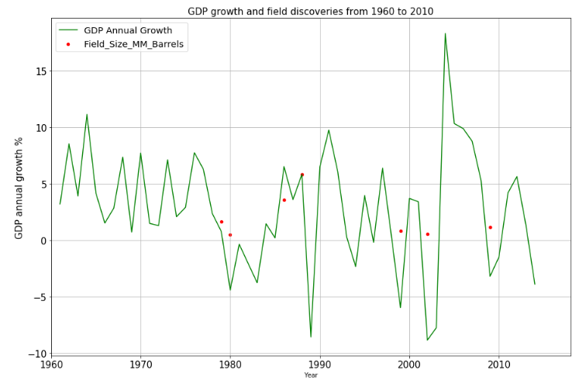
Data Exploration (1)
Poor correlation (0.1)between field size and GDP growth
Delayed Impact of field discovery on GDP growth (example from Venezuela)

Slide 10
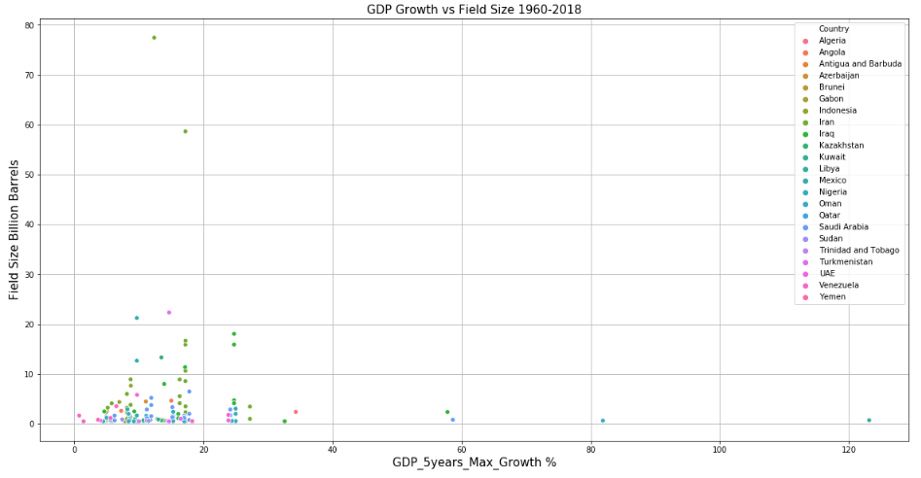
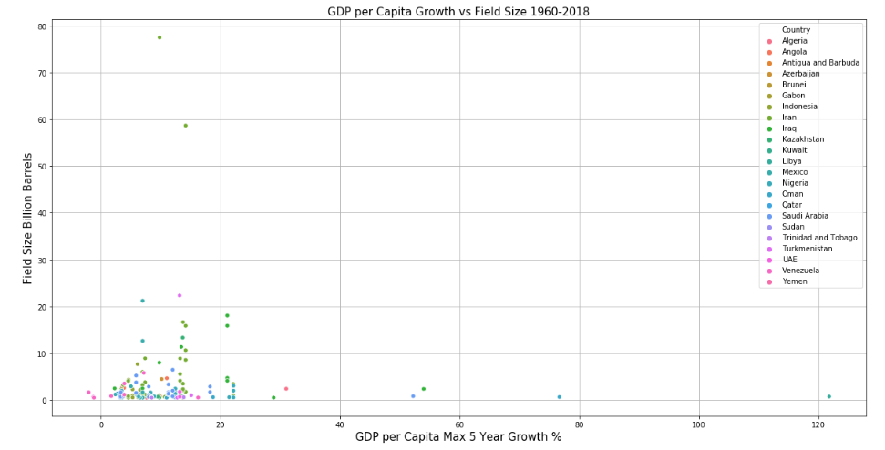
Data Exploration (2)
Determined maximum GDP growth and GDP per capita growth in the 5 years that followed a discovery
Plotted field size vs max GDP growth and max growth per capita
Most values concentrated in 0-25% range
GDP growth outliers (>40%) are typically associated with historical events

Slide 11
Dicussion
The analysis conducted on the dataset from the World Bank and field discoveries from the Harvard study showed some interesting results.
First, we did not find a correlation between discovery size and GDP growth. Some of the largest fields discovered in the last 50 years resulted in 10-15% maximum GDP growth, whereas significantly smaller discoveries had similar GDP growth or more over the 5-year period following their discovery.
Second, most of the highest GDP growth values observed for the same period are between 0-20%. Fewer countries experienced growth between 20-30% following a discovery and only a handful saw growth between 30-40%.
Finally, only 4 countries recorded more than 40% GDP growth in one or two years. Those represented a recovery from major geopolitical event or crisis, civil war or military invasion, for example the two Iraq military invasions (1990 and 2003) or the fall of Gaddafi in Libya (2011).

Slide 12
Conclusions
Based on these results it is difficult to imagine that the GDP growth of Guyana after brining the Stabroek discovery would be 86% in 2020, as this level of growth was historically relative to a recovery from major crisis.
The IHS market prediction of GDP growth at 30% seems more plausible, although our analysis would suggest a rate between 15 and 25% to be more in line with historical records of GDP growth observed in 24 oil income dependent countries over the last 50 years.
This analysis did not consider economic or political factors, nor any local conditions or context specific to Guyana that could still influence the estimation of the country's economic growth.

Slide 13
Additional Information and Code
https://gist.github.com/0d1236ac9c356cd6b3bb3922c793b856
Link to Github: https://gist.github.com/c78ee3209acce3b98884cbfab23de246
Data sources
World Bank
https://worldmap.harvard.edu/data/geonode:giant_oil_and_gas_fields_of_the_world_co_yxz

